Slide 1

CS401 Modern Programming Practices (MPP) Professor Renuka Mohanraj
MAHARISHI UNIVERSITY of MANAGEMENT
Engaging the Managing Intelligence of Nature
Computer Science Department

Slide 2
© 2015 Maharishi University of Management, Fairfield, Iowa
All rights reserved. No part of this slide presentation may be reproduced or utilized in any form or by any means, electronic or mechanical, including photocopying or recording, or by any information storage and retrieval system, without permission in writing from Maharishi University of Management.

Slide 3
Lecture 2: Associations, Modeling Relationships with UML
Diversifying Self-Referral Relationship
to the World of Objects

Slide 4
Wholeness Statement
In the real world, objects have relationships. These manifested relationships appear in many different ways. When these relationships are modeled in UML, those that reflect a permanent relationship are called associations.
At the most fundamental level every object in existence is made out of the same essence – and is therefore (in a way) related to everything. An intellectual analysis or model of all these relationships is generally not practical.
A direct experience of the underlying reality of all of manifest creation and our relationship with all of nature is a result of our practice of Transcendental Meditation.

Slide 5
Overview
Types of relationships between classes: association, dependency, inheritance
Techniques for discovering associations
Identify verb phrases
Create an association matrix
Aspects of associations
Unidirectional and bidirectional associations
Aggregation
Composition
Reflexive associations
Association classes
Dependency
Association “decorations”: name, roles, multiplicities

Slide 6
Relationships Between Classes
In the OO paradigm, there are three fundamental types of relationships that can exist between classes
Association
Dependency
Inheritance (discussed in Lesson 3)

Slide 7
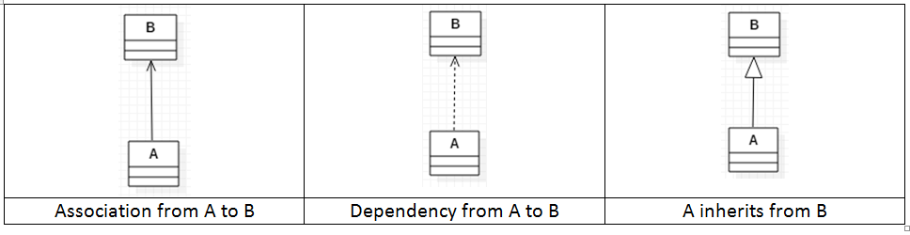
(continued)
Associations
“Customer has an Account”
Permanent relationship
Association from A to B implies A keeps a reference to B
Association from A to B implies it is possible to navigate from A to B at runtime
Dependencies
“RightTriangle uses Math” (see example)
Temporary relationship
Dependency from A to B implies A does not keep a reference to B
Demo: lesson2.lecture.dependencyexample

Slide 8
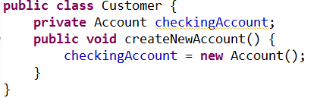
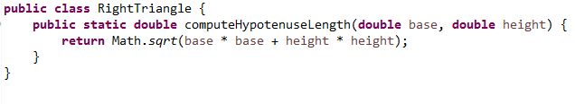
Two Examples
Association
Dependency

Slide 9
Dependency Example
public class Email {
public void sendEmail(String subject, String message){ System.out.println(“Subject : ” + subject + “\n Message : “ + message);
}
}
public class Person {
public void greetFriend(Email ob){
ob.sendEmail("Hello", "Hello my friend :)");
}
}
Notes:
SOLID: Single Responsibility Principle, Open-Closed Principle, Liskov Substitution Principle, Interface Segregation Principle, and Dependency Inversion Principle.

Slide 10


One-way and Two-way Associations
Sometimes should be able to navigate from A to B but not from B to A. This is a one-way or uni-directional association
Sometimes should be able to navigate from A to B and also from B to A. This is a two-way or bi-directional association

Slide 11
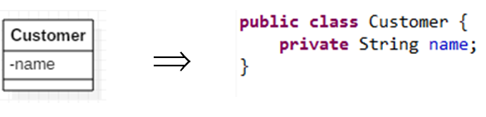
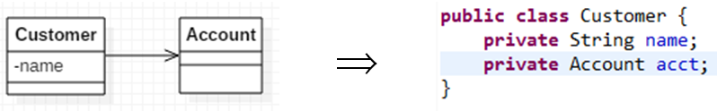
Properties as Attributes or Associations
An attribute of a UML class indicates a variable that stores data, like name in Customer. A UML attribute is implemented in Java code as a field or instance variable.
An association from one class to another is also implemented in Java code as a field or instance variable, like the association from Customer to Account

Slide 12
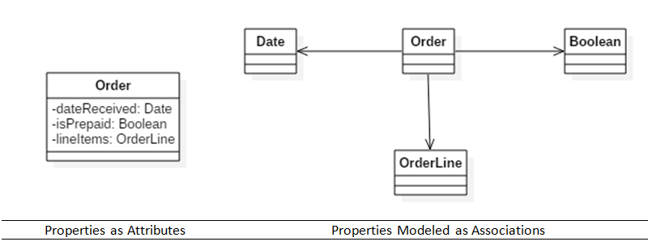
In the language of UML, both acct and name are called properties of Customer. The property acct is modeled as an association; the property name is modeled as an attribute.
In UML, it is always possible to model properties either as attributes or as associations:

Slide 13

Which way is best – properties as attributes or associations?
When a property has an internal structure, with its own properties, model it as an association; otherwise, as an attribute.
Example: In the previous example, an Order has many OrderLines, and each OrderLine has its own internal structure (cost, quantity, etc). So the OrderLine property should be modeled as an association; the others, as attributes
IMPORTANT: When a property is modeled as an association, it is not mentioned as one of the attributes of the class. Here, Order displays two attributes, one association. All three would appear as fields in a Java class implementation

Slide 14
Overview
Types of relationships between classes: association, dependency, inheritance
Techniques for discovering associations
Identify verb phrases
Create an association matrix
Aspects of associations
Unidirectional and bidirectional associations
Aggregation
Composition
Reflexive associations
Association classes
Dependency
Association “decorations”: name, roles, multiplicities

Slide 15
Name of an Association Is a Verb
Examples
Customer has an Account
Professor advises a Student
Student enrolls in a Section
Strategy:
Discover associations by finding verbs and verb phrases in the problem statement.
Optional: Track the relationships in an Association Matrix

Slide 16
Problem Description for the SRS
We have been asked to develop an automated Student Registration System (SRS) for the university. This system will enable students to register online for courses each semester, as well as track their progress toward completion of their degree.
When a student first enrolls at the university, he/she uses the SRS to create a plan of study that lists the courses he/she plans on taking to satisfy a particular degree program, and chooses a faculty advisor. The SRS will verify whether or not the proposed plan of study satisfies the requirements of the degree that the student is seeking.
Once a plan of study has been established, then, during the registration period preceding each semester, students are able to view the schedule of classes online and choose whichever classes they wish to attend, indicating the preferred section (day of the week and time of day) if the class is offered by more than one professor.

Slide 17
The SRS will verify whether or not the student has satisfied the necessary prerequisites for each requested course by referring to the student’s online transcript of courses completed and grades received (the student may review his/her transcript online at any time).
Assuming that (a) the prerequisites for the requested course(s) are satisfied, (b) the course(s) meet(s) one of the student’s plan of study requirements, and (c) there is room available in each of the class(es), the student is enrolled in the class(es).
If (a) and (b) are satisfied, but (c) is not, the student is placed on a first-come, first-served wait list. If a class/section that he/she was previously waitlisted for becomes available (either because some other student has dropped the class or because the seating capacity for the class has been increased), the student is automatically enrolled in the waitlisted class, and an email message to that effect is sent to the student. It is the student’s responsibility to drop the class if it is no longer desired; otherwise, he/she will be billed for the course.
Students may drop a class up to the end of the first week of the semester in which the class is being taught.

Slide 18
Association Matrix
 | Section | Course | Plan of Study | Professor | Student | Transcript
Section |  | instance of |  | is taught by
Course
Plan of Study
Professor
Student
Transcript

Slide 19
 | Section | Course | Plan of Study | Professor | Student | Transcript
Section |  | instance of |  | is taught by |  | included in
Course | offered as | prerequisite for | is called for by
Plan of Study |  | calls for |  |  | observed by
Professor | teaches |  |  |  | advises; teaches
Student | registered for; waitlisted for; has previously taken | plans to take | observes | is advised by; studies under |  | owns
Transcript | includes | includes |  |  | belongs to

Slide 20
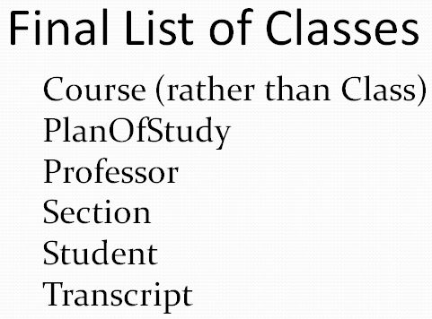
Exercise 2.1: Specifying Associations in the SRS
In your small group create a diagram with all the classes and their associations – show association names

Slide 21
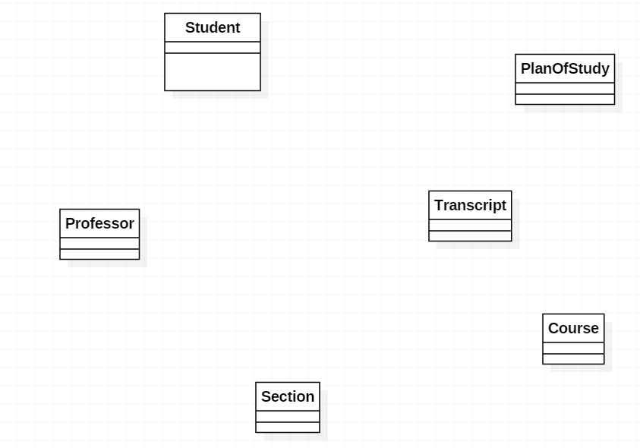

Slide 22
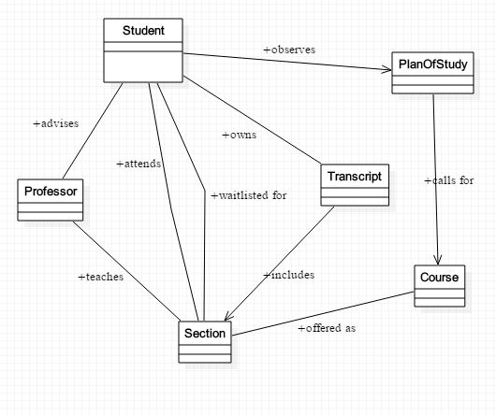
Student Registration System

Slide 23
Main Point 1
Building a software system using OO principles involves an analysis step in which the problem is analyzed and broken into pieces as objects are discovered. The pieces are then refined and put together – in a step of synthesis – to give a picture of a unified system. This step of synthesis happens in part through the identification of relationships between classes, represented by associations.
This phenomenon is a characteristic of all knowledge – it arises through a combination of analysis and synthesis.

Slide 24
Quiz 1
1. Which one of the following indicates temporary relationship between the classes?
a. Inheritance
b. Association
c. Dependency

Slide 25
Overview
Types of relationships between classes: association, dependency, inheritance
Techniques for discovering associations
Identify verb phrases
Create an association matrix
Aspects of associations
Unidirectional and bidirectional associations
Aggregation
Composition
Reflexive associations
Association classes
Dependency
Association “decorations”: name, roles, multiplicities

Slide 26
Association - Unidirectional
Unidirectional
Objects of a class have a reference to an object of another class.
The association can be given a descriptive name (a verb), often with a direction indicator [some UML tools do not support direction indicators]
Customer
puts items in
ShoppingCart
public class Customer {
private ShoppingCart cart;
}
public class ShoppingCart{
}

Slide 27
Association: Multiplicities
Determining Multiplicity
Ask:
For a given instance of a class A and
association involving A, B, how many
instances of B must/may be associated
with this instance of A?
Optionality
Is the association required? If not, association will be “zero or more”; otherwise, it will be “one or more”
Cardinality
How many instances are associated with a given instance? Could be 1:1, 1:2, 1:3, 1..* (for example)
UML combines both ideas in the concept of multiplicity
UML supports a variety of multiplicities
1 one (mandatory)
three (exactly)
* many
0..* zero or more (optional)
1..* one or more
0..1 zero or one (optional)

Slide 28
Unidirectional with Multiplicities
A unidirectional association may be 1-0..1, 1-1, or one-many.
Customer
puts items into
ShoppingCart
1
1
One-one Multiplicity:
Associated with each Customer, there is exactly one ShoppingCart
Associated with each ShoppingCart, there is exactly one Customer
It is possible to navigate from a Customer to his ShoppingCart, but not from ShoppingCart to Customer.
Maintaining the relationship means:
when new Customer object is created, it is equipped with a ShoppingCart
it is not possible to add a second ShoppingCart to a Customer object
it is not possible to create a ShoppingCart on its own; it must be created as a property of a Customer object.

Slide 29
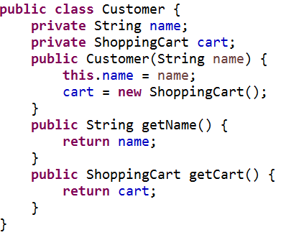
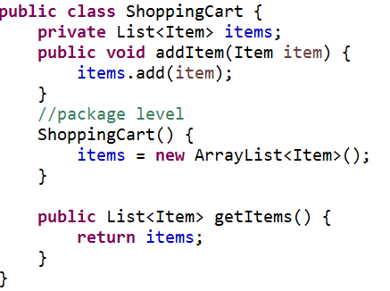
Example: 1-1 and Unidirectional
See lesson2.lecture.unidirectional.oneone

Slide 30
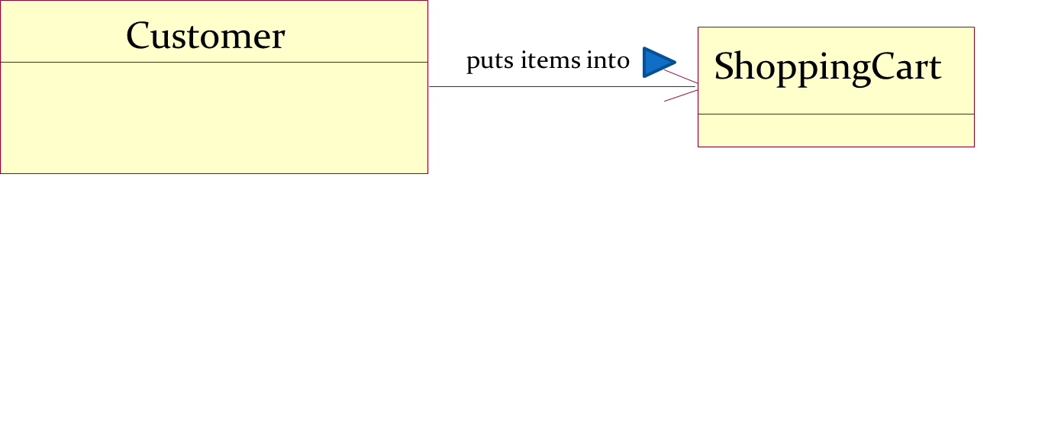
Unidirectional with Multiplicities
1
0..1
One to zero..one Multiplicity:
Associated with each Customer, there is zero or one ShoppingCart
Associated with each ShoppingCart, there is exactly one Customer
It is possible to navigate from a Customer to his ShoppingCart, but not from ShoppingCart to Customer.
Maintaining the relationship means:
Customer class has a shopping cart variable that may be populated
it is not possible to add a second ShoppingCart to a Customer object
it is not possible to create a ShoppingCart without an owning Customer object.

Slide 31
Example: Unidirectional, One to Zero..One(Easy)
public class ShoppingCart {
private List<Item> items;
public void addItem(Item item) {
items.add(item);
}
/** package level constructor */
ShoppingCart() {
items = new ArrayList<Item>();
}
public List<Item> getItems() {
return items;
}
}
public class Customer {
private String name;
private ShoppingCart cart;
public Customer(String name) {
this.name = name;
}
public String getName() {
return name;
}
public void addCart() {
if(cart == null)
cart = new ShoppingCart();
}
public ShoppingCart getCart() {
return cart;
}
}
See: lesson2.lecture.unidirectional.oneToZeroOneEasy

Slide 32
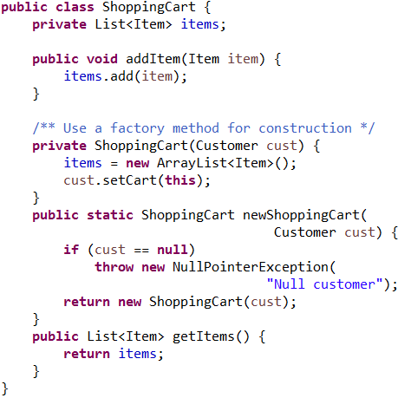
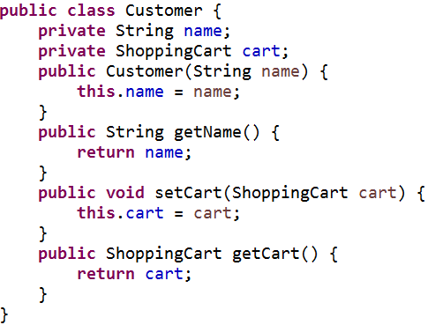
Example: Unidirectional, One to Zero..One
See: lesson2.lecture.unidirectional.oneToZeroOne

Slide 33
Unidirectional with Multiplicities
Customer
places
Order
1
0..*
One-many Multiplicity:
Associated with each Customer, there are zero or more Orders
A Customer object maintains a collection of Order objects.
Associated with each Order, there is exactly one Customer
It is possible to navigate from a Customer to any of his Orders, but not from an Order to the owning Customer.
Maintaining the relationship means:
when new Customer object is created, it is equipped with a (possibly empty) collection of Orders
it is not possible to create an Order object independent of a Customer; each new Order object must belong to the collection of Orders for some Customer.

Slide 34
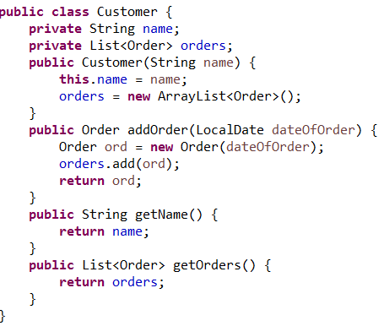
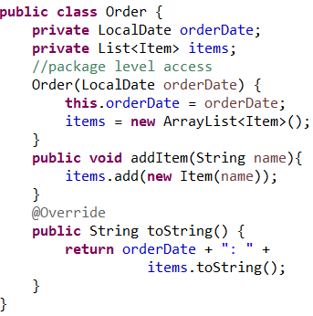
Example: Unidirectional, 1-many
\lesson2\lecture\unidirectional\onemany

Slide 35
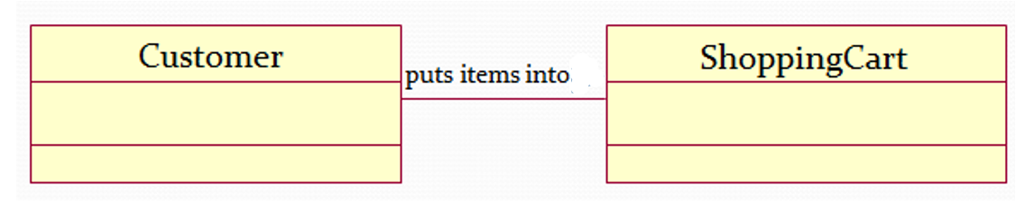
Bidirectional with Multiplicities
1
1
One-one Multiplicity:
Associated with each Customer, there is exactly one ShoppingCart, and Customer contains a reference to its ShoppingCart
Associated with each ShoppingCart, there is exactly one Customer, and ShoppingCart contains a reference to its owning Customer
It is possible to navigate from a Customer to his ShoppingCart, and also from ShoppingCart to Customer.
Maintaining the relationship implies:
when new Customer object is created, it is equipped with a ShoppingCart and a new ShoppingCart is equipped with a reference to its owning Customer
it is not possible to add a second ShoppingCart to a Customer object

Slide 36
(continued)
Implementation Strategies:
One of the classes owns the relationship. If Customer owns the relationship, ShoppingCart is created when Customer is created, and only then. OR
The owner of the relationship is external to the two classes involved.
Examples of both of these are in these demos:
lesson2.lecture.bidir.onetoone
lesson2.lecture.birdir.onetoone_factory

Slide 37

Bidirectional with Multiplicities
One-many Multiplicity:
ShoppingCart maintains a collection of zero or more Items and each Item contains a reference to its owning ShoppingCart.
Items cannot be created outside the context of an owning ShoppingCart
Maintaining the relationship implies:
when new ShoppingCart is created, it is equipped with a (possibly empty) collection of Items; when an Item is created, a reference to its owning ShoppingCart is stored in the Item.

Slide 38
(continued)
Implementation Strategies:
The "one" class (of one-many) owns the relationship. If ShoppingCart owns the relationship in above example, a list of Items is created when ShoppingCart is created, and each Item stores this instance of ShoppingCart. OR
The owner of the relationship is external to the two classes involved.
See demo
lesson2.lecture.bidir.onetomany

Slide 39
Exercise 2.2: Multiplicities in SRS?

Slide 40
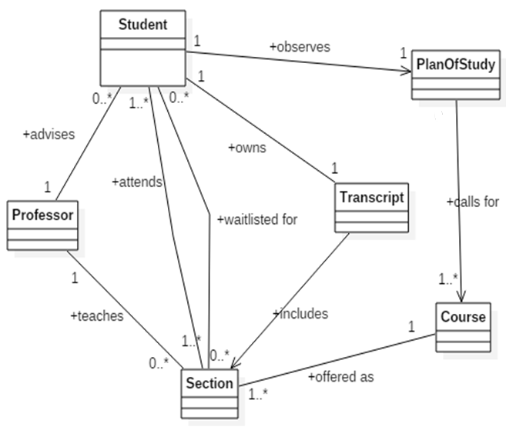
Solution

Slide 41
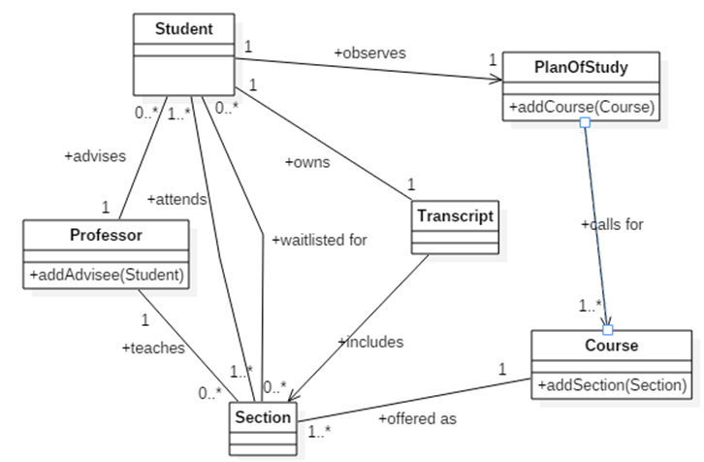
Associations Sometimes Suggest Operations
Notes:
Professor teaches many sections.

Slide 42
Association roles
A role is a (noun) description placed on either side of the association to indicate the role(s) each object plays in the relationship. Specifying roles is optional.
Student
advises
Faculty
0..*
1
- advisees
- advisor
public class Student {
private Faculty advisor;
}
public class Faculty {
private List<Student> advisees;
}

Slide 43
Main Point 2
Associations model the relationships that can exist between concepts. Simple (one-way) associations are modeled using an arrow; two-way associations are modeled using a line segment.
The association can have a name for ease of reading, and additional symbols to indicate direction and multiplicity.
The ends of an association arrow can also specify association roles.
The “simplest” association is the relationship of pure consciousness to itself; this can also be modeled with an arrow from pure consciousness to itself.

Slide 44
Exercise 2.3
For the problem statement on the next slide, do the following:
Work independently for 10 minutes to create the class diagram. Display the associations that are needed.
Then review your diagrams for 10 minutes with your small group.

Slide 45
Exercise 2.3
A Human Resource (HR) department keeps track of employees for several companies, which it does using an Admin module in a software system. Each company has a name and is composed of one or more departments. A department has a name and a location. Each department has one or more job positions. A position has a title and a short description. Either a position is vacant or an employee is assigned to it. An employee has an id, title, first name, last name, birthdate, hire date, salary, and social security number . The HR department accesses the Admin module periodically to prepare a report for one of its companies. To do this, the company provides a list of all its employees. To prepare a report, the Admin module extracts from each employee record just the employee id, hire date, and salary, and then pieces together other information to create the final report. [Hint: Think of the HR dept as an actor.]

Slide 46
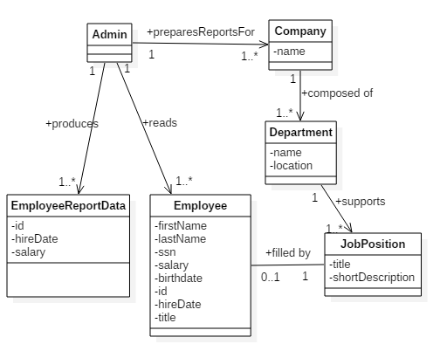
Solution

Slide 47
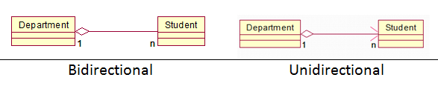
Aggregation
Represents a ‘whole-part’ relationship
‘contains’
‘is part of’
Code looks the same as an association.
Association name is implied
public class Department {
private List<Student> students;
}
public class Student {
private Department department;
}

Slide 48
Composition
Strong aggregation
‘whole-part’ relationship – “is composed of”
If whole dies, parts also die.
Company
Department
1
1..*

Slide 49
Composition
How to implement in code? There is no way (using Java) to ensure the composition relationship without using additional classes (beyond the two classes involved in the relationship).
Company
Department
1
1..*

Slide 50
Reflexive Association
Relationship between two or more objects of the same class.
association role
prerequisites
hasAsPrerequisites
0..*
Course
How can this relationship be expressed in code?

Slide 51
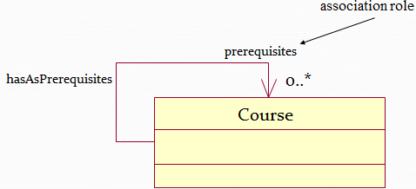
Reflexive Association
Relationship between two or more objects of the same class.
public class Course {
private List<Course> prerequisites;
}

Slide 52
Association Classes
We sometimes find ourselves in a situation where we identify an attribute that is critical to our model, but which doesn’t seem to fit nicely into any one class.
As an example, let’s revisit the (many-to-many) association “a Student attends a Section,”
Association Classes are useful to contain attributes of the link between objects.
These are often modeled this way during analysis
Refer : Beginning Java Objects Pages file 425-429 or Book Page – 397-403
Student
attends
Section
*
*
GradeReceived
grade: String

Slide 53
Association Class - reworked
During design, association classes are often re-worked to reflect the code instead of the concepts
Student
Section
gets
GradeReceived
issues
1
*
grade: String
*
1
*
attends
*
public class Section {
int sectionNumber;
List<Student> enrolledStudents;
List<GradeReceived> gradeSheets;
}
public class Student {
List<Section> sectionsEnrolledIn;
List<GradeReceived> evaluationsReceived;
}
public class GradeReceived{
Student student;
Section section;
String grade;
}

Slide 54
Managing Bidirectional Many to Many Relationships
This kind of implementation can be much involved and error-prone, but is sometimes necessary. Sometimes it is possible to refactor so that the association is only one-way (and therefore much easier to implement).
The safest approach for implementing a many-many association is to use a factory class to create instances of the classes involved in the relationship.

Slide 55
Dependency
An Association always implies a permanent relationship, since an instance of the target class is stored in the source class.
Sometimes, only a temporary relationship is needed – for instance, an instance of a target class may be needed in order to read or set some values inside a method call, but the relationship need not endure after the method returns.
Temporary relationships are modeled as dependencies.
When creating a class diagram during analysis, assume all relationships are associations. Later (during design), review your work to see if some of the associations really ought to be dependencies.

Slide 56
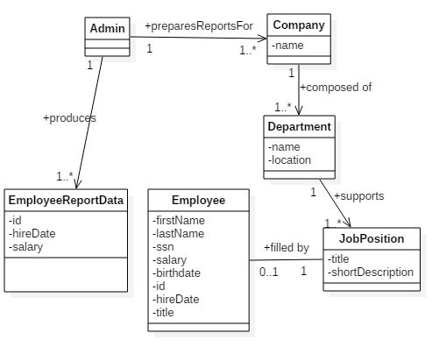
Example
In the previous exercise, Admin does not need to keep a reference to all Employees in order to create EmployeeReportData – dependency is good enough
dependency

Slide 57
Main Point 3
There are several special forms of association, such as reflexive associations, aggregation, composition, and association classes, and dependency is a further refinement
Although most of these have their own symbols, you could still model these relationships without them.
The use of the symbols is to (easily) communicate additional information about the relationship.
Even these additional symbols are still based on the simple concept of an arrow. This is an example of diversity on the basis of unity.

Slide 58
Exercise 2.4
Draw a UML class diagram for the following.
Doubly-Linked List:
A LinkedList consists of zero or more ListItems. Each ListItem knows its previous and its next ListItem, if any.

Slide 59
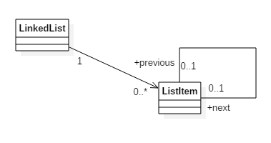
Solution
Doubly Linked List

Slide 60
Summary
Modeling associations:
We can use an association matrix to analyze what the relationships are between classes
Associations are modeled with a line or arrow, and, optionally, a name describing the association, numbers on each side to indicate multiplicity, roles at either end of the association, and an arrow for directionality.
Reflexive associations, aggregation, composition, association classes, and dependencies are further refinements of the concept of an association.

Slide 61
Connecting the Parts of Knowledge With the Wholeness of Knowledge
Class diagrams are defined in terms of classes and their relationships (associations)
Although there are various special association forms (composition, aggregation, etc.), all are variations of the fundamental concept of an association from one object to another.
Transcendental consciouness is related to itself through its own self-referral dynamics.
Wholeness moving within itself: In Unity Consciousness, one recognizes that the relationship of the Self to the Self is not only fundamental, but is in reality the only relationship there is.

